Slide 1
Essential Concepts in ML

Slide 2
Curse of dimensionality
Increasing dimensionality of features increases the data requirements exponentially.
For example, if a single feature can be accurately approximated with 100 data points, to optimize the joint over two features requires 100*100 data points.
Representation is also difficult

Slide 3
Generalization
Components of generalization error
Bias: how much the average model over all training sets differ from the true model?
Error due to inaccurate assumptions/simplifications made by the model
Variance: how much models estimated from different training sets differ from each other
Underfitting: model is too “simple” to represent all the relevant class characteristics
High bias and low variance
High training error and high test error
Overfitting: model is too “complex” and fits irrelevant characteristics (noise) in the data
Low bias and high variance
Low training error and high test error
Slide credit: L. Lazebnik

Slide 4
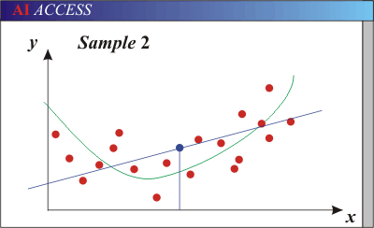
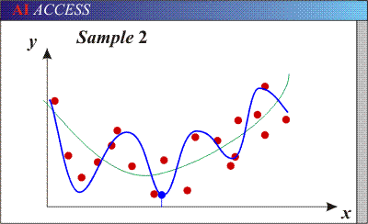
Bias-Variance Trade-off
Models with too few parameters are inaccurate because of a large bias (not enough flexibility).
Models with too many parameters are inaccurate because of a large variance (too much sensitivity to the sample).
Slide credit: D. Hoiem
Notes:
http://www.aiaccess.net/English/Glossaries/GlosMod/e_gm_bias_variance.htm

Slide 5
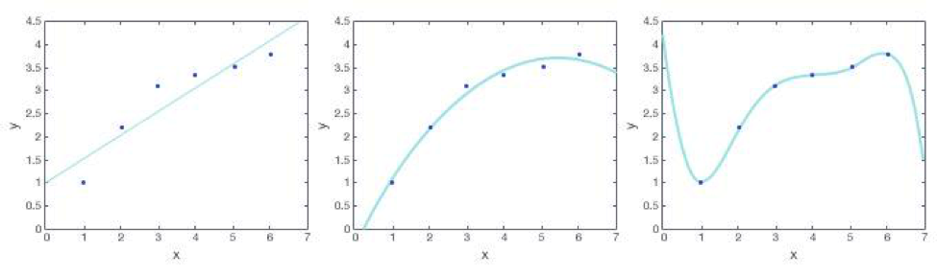
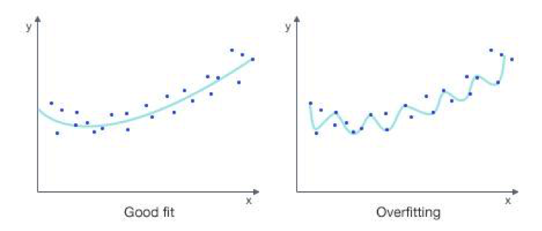

Slide 6
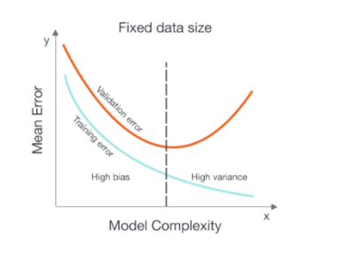
how do we know when we are overfitting the data?
Underfitting – Both validation error and training error are high
Overfitting – Validation error is high while training error is low
Good fit – Validation error is low, and only slightly higher than the training error

Slide 7
Bias-variance tradeoff
Underfitting
Overfitting
Error
Test error
Training error
High Bias
Low Variance
Complexity
Low Bias
High Variance
Slide credit: D. Hoiem

Slide 8
Bias-variance tradeoff
Few training examples
Test Error
Many training examples
High Bias
Low Variance
Complexity
Low Bias
High Variance
Slide credit: D. Hoiem
Notes:
Note: these figures don’t work in pdf

Slide 9
Effect of Training Size
Fixed prediction model
Error
Testing
Generalization Error
Training
Number of Training Examples
Slide credit: D. Hoiem

Slide 10
The perfect classification algorithm
Objective function: encodes the right loss for the problem
Parameterization: makes assumptions that fit the problem
Regularization: right level of regularization for amount of training data
Training algorithm: can find parameters that maximize objective on training set
Inference algorithm: can solve for objective function in evaluation
Slide credit: D. Hoiem

Slide 11
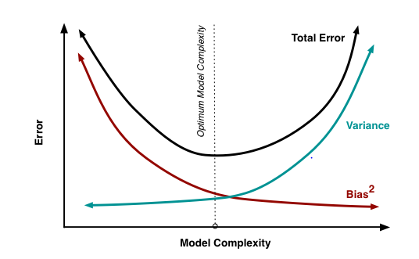
There is no escaping the relationship between bias and variance in machine learning.
Increasing the bias will decrease the variance.
Increasing the variance will decrease the bias.

Slide 12
How to reduce variance & bias?
Variance:
Choose a simpler classifier
Regularize the parameters
Get more training data
Bias:
Try a larger set of features.
Slide credit: D. Hoiem
Notes:
The simpler classifier or regularization could increase bias and lead to more error.

Slide 13
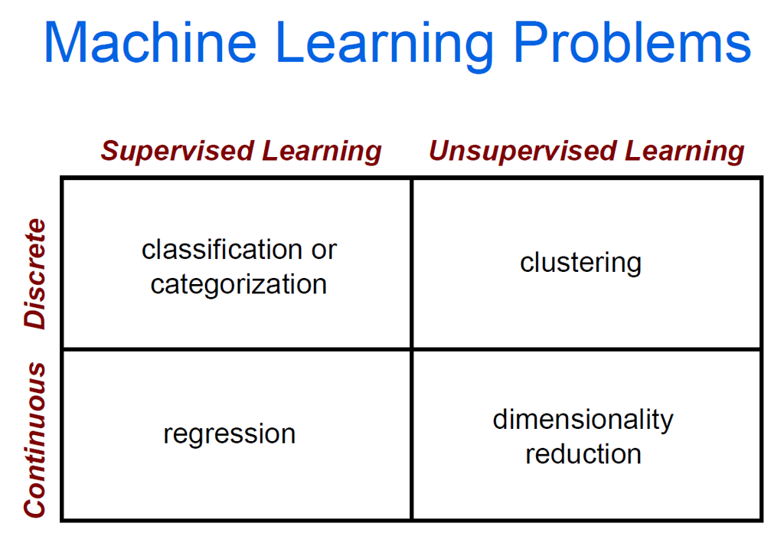

Slide 14



The machine learning framework
Apply a prediction function to a feature representation of the image to get the desired output:
f( ) = “apple”
f( ) = “tomato”
f( ) = “cow”
Slide credit: L. Lazebnik

Slide 15
The machine learning framework
y = f(x)
Training: given a training set of labeled examples {(x₁,y₁), …, (x_{N},y_{N})}, estimate the prediction function f by minimizing the prediction error on the training set
Testing: apply f to a never before seen test example x and output the predicted value y = f(x)
output
prediction function
Image feature
Slide credit: L. Lazebnik

Slide 16
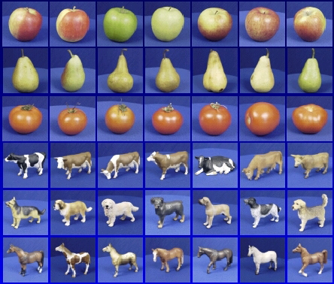

Steps
Training
Training Labels
Training Images
Image Features
Training
Learned model
Testing
Image Features
Learned model
Prediction
Test Image
Slide credit: D. Hoiem and L. Lazebnik

Slide 17
Many classifiers to choose from
Which is the best one?
SVM
Neural networks
Naïve Bayes
Bayesian network
Logistic regression
Randomized Forests
Boosted Decision Trees
K-nearest neighbor
RBMs
Etc.
Slide credit: D. Hoiem

Slide 18
Classification measures
Accuracy is one of the measure (error = 1-accuracy).
Accuracy is not suitable in some applications.
In classification involving skewed or highly imbalanced data, e.g., network intrusion and financial fraud detections, we are interested only in the minority class.
High accuracy does not mean any intrusion is detected.
E.g., 1% intrusion. Achieve 99% accuracy by doing nothing.
The class of interest is commonly called the positive class, and the rest negative classes.

Slide 19
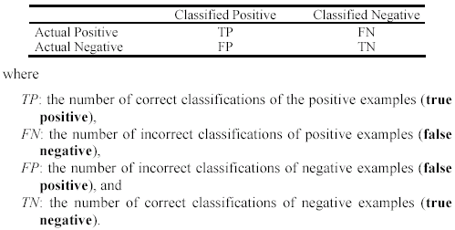
Precision and recall measures
Used in information retrieval and text classification.
We use a confusion matrix to introduce them.

Slide 20

Precision and recall measures (cont…)
Precision p is the number of correctly classified positive examples divided by the total number of examples that are classified as positive.
Recall r is the number of correctly classified positive examples divided by the total number of actual positive examples in the test set.

Slide 21

An example
This confusion matrix gives
precision p = 100% and
recall r = 1%
because we only classified one positive example correctly and no negative examples wrongly.
Note: precision and recall only measure classification on the positive class.

Slide 22


Receive operating characteristics curve
It is commonly called the ROC curve.
It is a plot of the true positive rate (TPR) against the false positive rate (FPR).
True positive rate:
False positive rate:

Slide 23
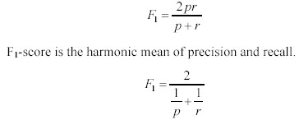
F₁-value (also called F₁-score)
It is hard to compare two classifiers using two measures. F₁ score combines precision and recall into one measure
The harmonic mean of two numbers tends to be closer to the smaller of the two.
For F₁-value to be large, both p and r much be large.

Slide 24


Sensitivity and Specificity
In statistics, there are two other evaluation measures:
Sensitivity: Same as TPR
Specificity: Also called True Negative Rate (TNR)
Then we have

Slide 25
Linear Regression
Sumanth Reddy Kaliki
AI Tech Lead
Renoworks - Canada

Slide 26
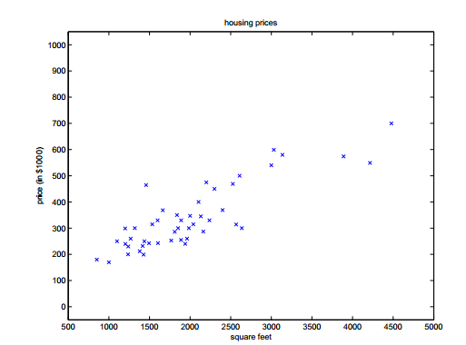
Definition
Output is Linear Combination of input variables,
W1, w2…..wp=coefficients
W0=bias or intercept
Linear Regression is used for Continuous output
values
In the figure shown, we need to fit a line passing
through the points

Slide 27
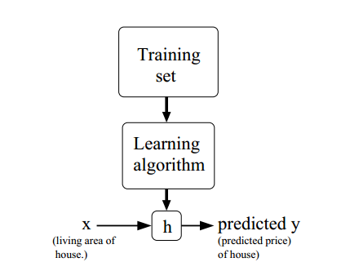

Slide 28
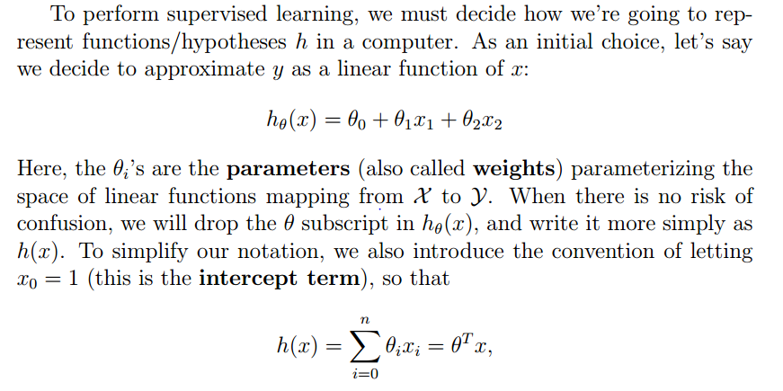

Slide 29
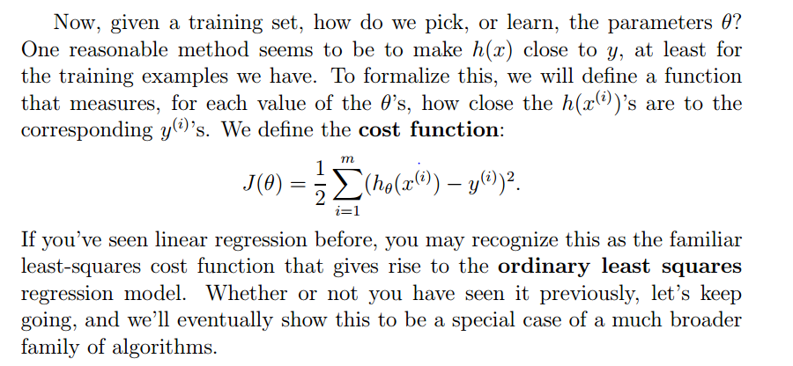

Slide 30
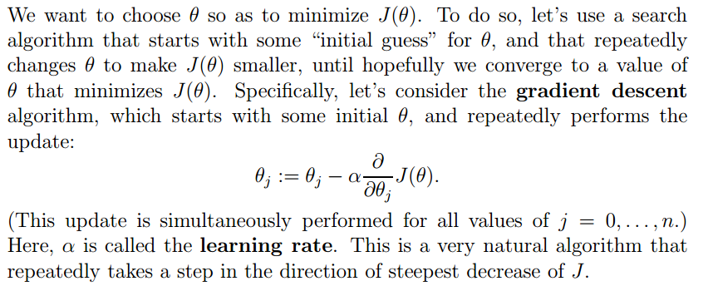
Least Mean Square(LMS) regression Model

Slide 31
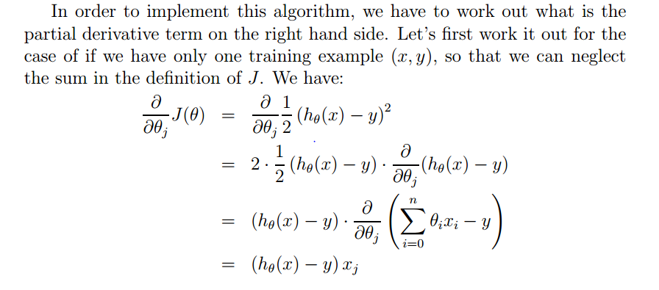
Least Mean Square(LMS) regression Model

Slide 32
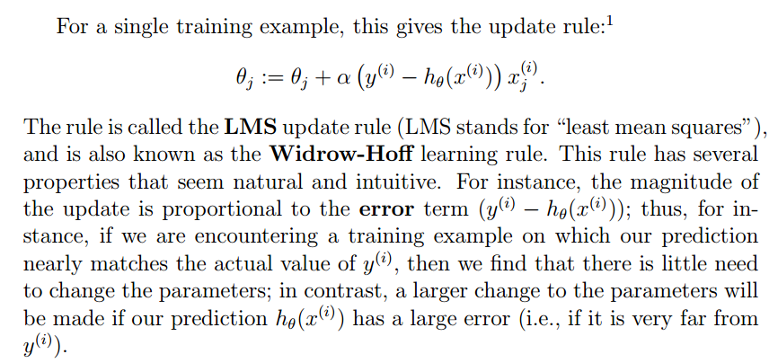
Least Mean Square(LMS) regression Model

Slide 33
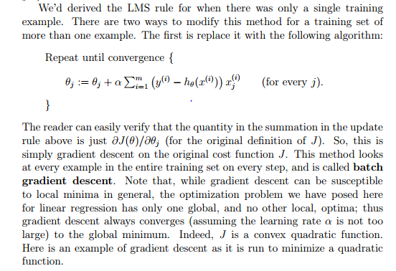

Slide 34
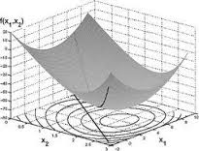
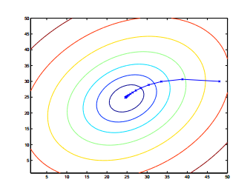

Convex Optimization using gradient descent

Slide 35
Make a guess? What does it mean?...
Hypothesis /guess :
weights
Notes:
But what it actually means… to make a guess?
Guess that we were making in the simplest case is a line.
As you know from the high school, a straight line is represented as a function f(x) = ax + b.
To draw the random guess line we need to know at least two points to draw it through.
So to make a guess literally means to choose two random points we are going to draw the line through. That is the simplest case
If we have N input parameters or predictors we’d have to think of N random values to make a guess.
This random values we’ll can theta parameters, they are also called weights.

Slide 36


Find out our mistake…
Cost function/ Mistake function:
Gradient Descent to find the global minimum.
… and minimize it:
Notes:
Now we have training data and we have a guess that we’ve made.
Now the goal is to measure how wrong we are and what is the mistake.
How can we do it? We can, because for training data we have both inputs and already known outputs for them.
What we can do now is to send out inputs from the training set to our guess function that we’ve made and …
… to compare the output of the guess function and the actual known output that we have for the given data sample from the training set.
To compare it we are defining our COST function or MISTAKE function
It is defined as the squared error function that, for each data sample from the training data finds the difference between the guess and the output.
Basically, what the mistake function gives to us?
It shows how wrong our randomly selected weights or theta parameters are..
What are we going to do with the mistake? We want to reduce the mistake in our guess!
To reduce the mistake we should minimize our mistake function
We should find the minimum of the mistake function, so we’ll know the point where our guess is least wrong.
And why do we need this all? To find out the correct values of weights so we’ll be able to make the perfect fit for our data!

Slide 37
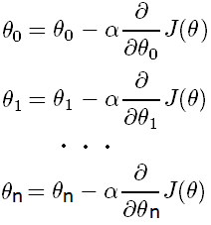
How to reduce the mistake?
Update each slope parameter until Mistake Function
minimum is reached:
Alpha
Learning rate
Derivative
Direction of moving
Simultaneously
Notes:
So, the process of moving towards the minimum until we reach it is basically the simultaneous update of all our random guess theta parameters
When we update each theta parameter we are updating it to move the direction of the minimum with the step defined by the learning rate.
Here the learning rate is alpha, and the direction is defined from the partial derivative of the mistake function for the given theta parameter.
And we are doing this iteratively until we end up at the minimum, where the derivative should be either 0, or very close to 0.

Slide 38
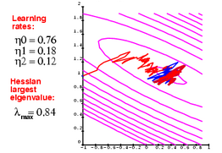
A Note on Stochastic GD
Global Minimum
For very large problems it is more efficient to
compute the gradient using a small (random)
subset of the data.
For every new update you pick a new random subset.
Towards convergence, you decrease the stepsize.
Why is this more efficient?
The gradient is an average over many data-points.
If your parameters are very “bad”, every data-point will
tell you to move in the same direction, so you need only a
few data-points to find that direction.
Towards convergence you need all the data-points.
A small step-size effectively averages over many data-points.

Slide 39
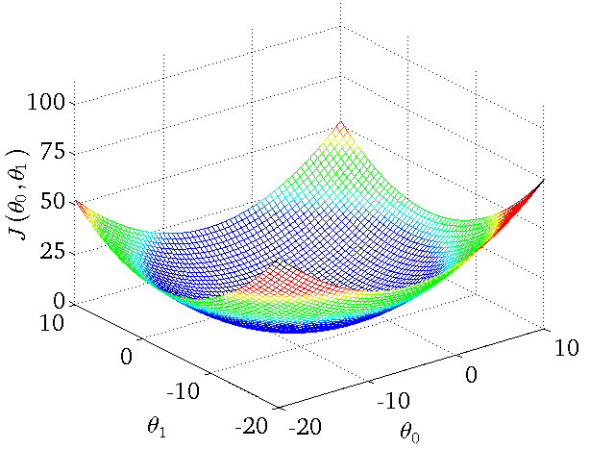
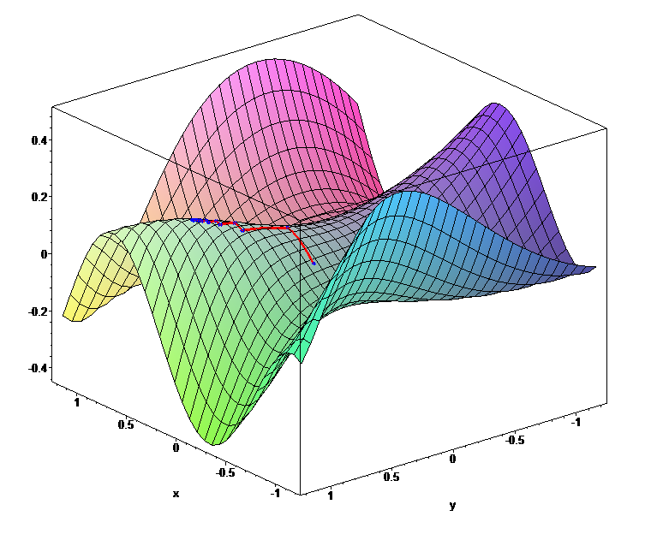
Mistake function looks like…
Global minimums
Notes:
To imagine the cost or mistake function… it can look like this..
When our initial guess theta parameters are wrong, we would be located at the random point on the shape.
When we are minimizing the mistake function, we should literally find the way from the point we are to the minimum of the function.
But how do we know where the minimum is?
First, we can find out the direction, where we should move from our point towards the minimum.
How can we find the direction? If we find the derivative of the mistake function at the point we are – it can be either positive or negative
Positive means that the tangent looks that way and minimum is on the left, so we should move left.. If it’s negative, it means minimum is on the right and we should go right
In addition to the direction of moving towards the minimum we should define the learning rate, that is the size of the step we are making.
If the step is too big then we can overjump the minimum. If it’s too small we may learn very very slowly.

Slide 40
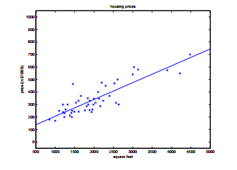
Regression for data shown initially

Slide 41
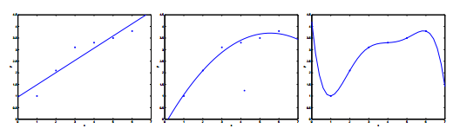
Under-fitting, Optimum, Overfitting

Slide 42
Effects of Under-fitting(High Bias) & Overfitting(High Variance)

Slide 43
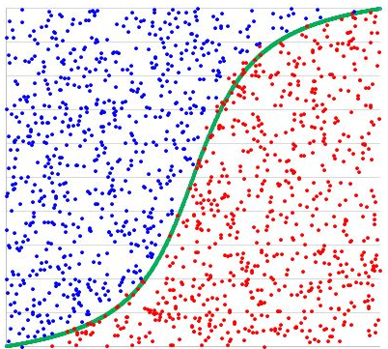
Logistic Regression
Output is not a number from some continuous range – output is the category (black or white, yes or no)
Logistic regression is a classification algorithm that may have only two categories on the output, so it’s binary classification
Name is somewhat misleading. Really a technique for classification, not regression. “Regression” comes from fact that we fit a linear model to the feature space.
Notes:
Classification.
Output is not a number from some continuous range – output is the category (black or white, yes or no)
Logistic regression is a classification algorithm that may have only two categories on the output, so it’s binary classification

Slide 44
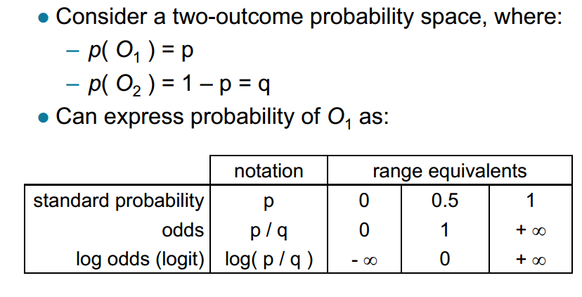
Different ways of expressing probability
Notes:
Maximum likelyhood

Slide 45
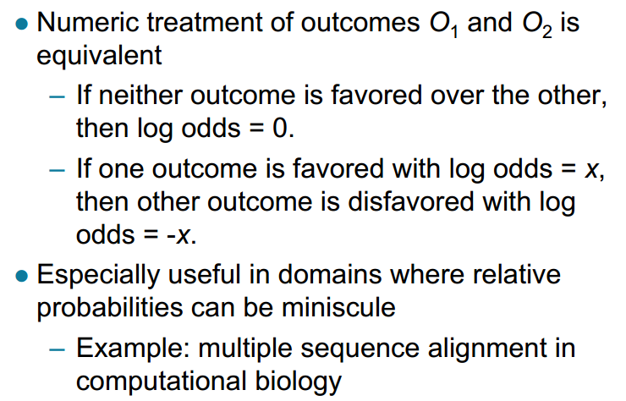
Log odds

Slide 46
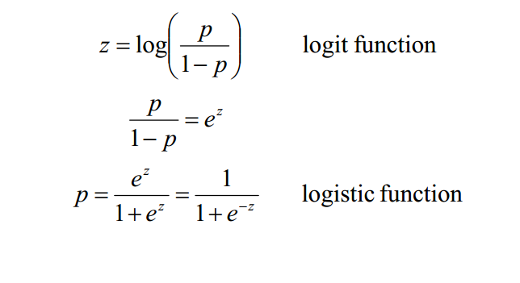
From probability to log odds (and back again)

Slide 47
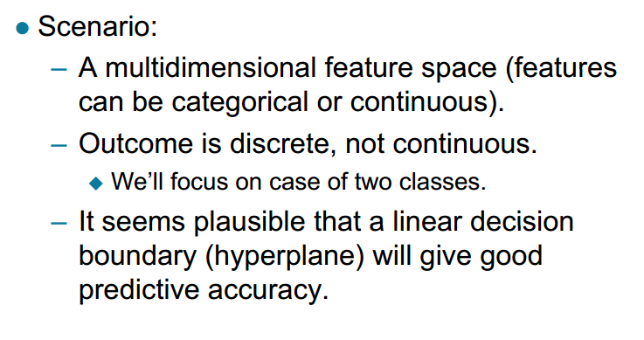
Logistic Regression

Slide 48
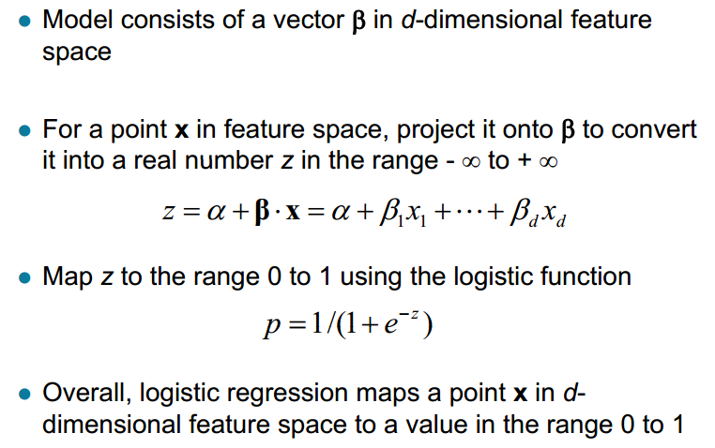
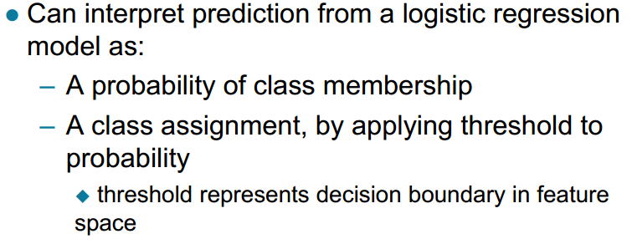
Using Logistic Regression Model

Slide 49
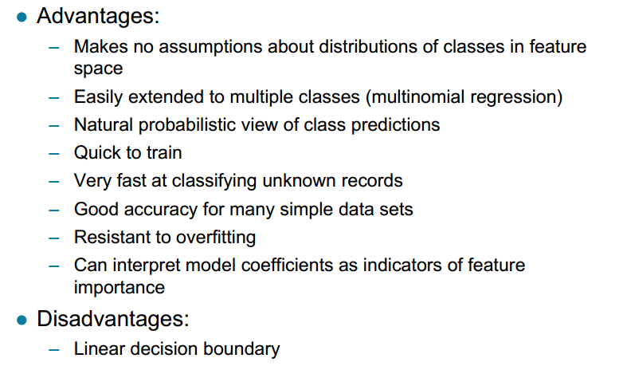
Logistic Regression

Slide 50
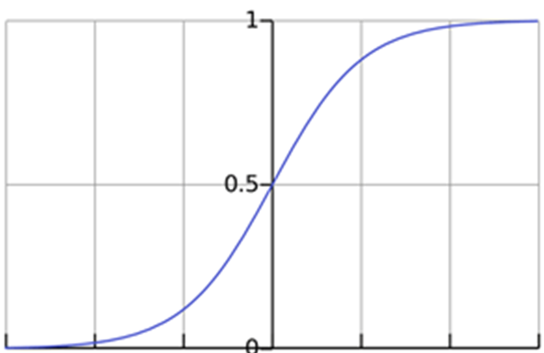

Hypothesis function
Estimated probability that Y = 1 on input X
Squashing function to map the reals to a finite domain.
Notes:
Here we also have our guess or hypothesis function, that is different here.
In the simplest Linear Regression it was a line, here as the outcome is categorical we have the guess function that outputs the estimated probability that the output would be equal to one for the given set of inputs.
This function is called sigmoid or logistics function.
And here we also have the set of random theta parameters or weights, that are located in the degree of e at the bottom part of the equation.

Slide 51
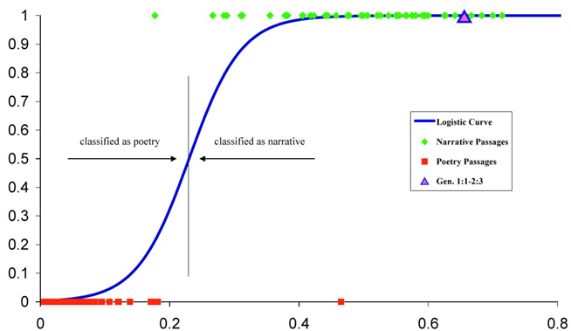
The logit / sigmoid
Determines the offset
Determines the angle
and the steepness.

Slide 52
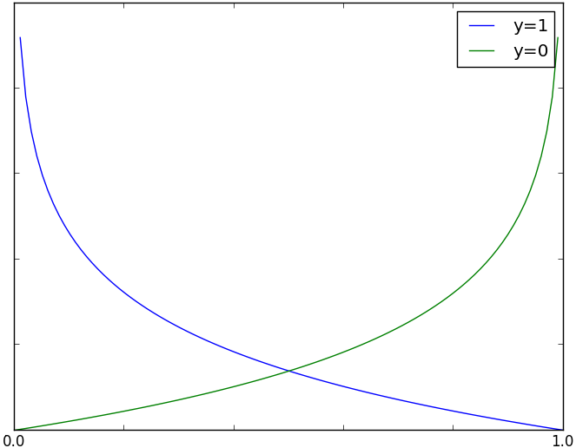
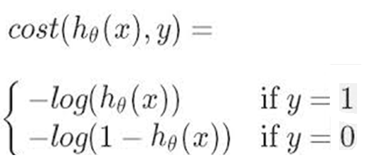
Mistake function
Mistake function is the cost for a single training data example
h(x)
Notes:
The mistake function here for each training sample can be divided into two parts.
As out outcome can be either one category or another category, so either 0 or 1 ….
…. Then, if the real outcome for the data sample of predictors is really 1, and our guess function outputs 0 – then the mistake should grow when the guess decreases
… if the real outcome is 0, and our guess is 1, which is wrong.. Then out mistake should increase as our guess value increases.
That is the mistake function for separate data samples

Slide 53
K-Nearest Neighbours

Slide 54
K-Nearest Neighbours
Also called Lazy Learning or Instance Based Learning
Neighbours-based classification is a type of instance-based learning or non-generalizing learning: it does not attempt to construct a general internal model, but simply stores instances of the training data. Classification is computed from a simple majority vote of the nearest neighbours of each point: a query point is assigned the data class which has the most representatives within the nearest neighbours of the point.

Slide 55
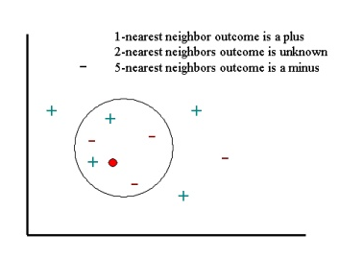
K-Nearest Neighbours
To demonstrate a k-nearest neighbour analysis,
let's consider the task of classifying a new object
(query point) among a number of known examples.
This is shown in the figure below, which depicts the
examples (instances) with the plus and minus signs
and the query point with a red circle. Our task is to
estimate (classify) the outcome of the query point
based on a selected number of its nearest neighbours.
In other words, we want to know whether the query
point can be classified as a plus or a minus sign.

Slide 56
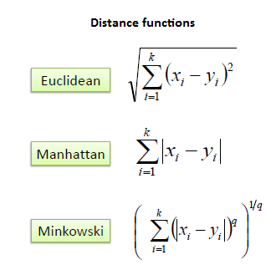
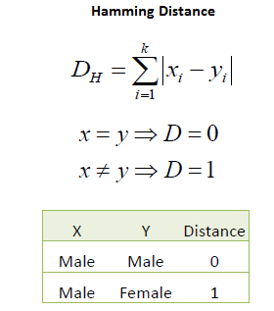
A case is classified by a majority vote of its neighbours, with the case being assigned to the class most common amongst its K nearest neighbours measured by a distance function. If K = 1, then the case is simply assigned to the class of its nearest neighbour.
It should also be noted that all three distance measures are only valid for continuous variables. In the instance of categorical variables the Hamming distance must be used. It also brings up the issue of standardization of the numerical variables between 0 and 1 when there is a mixture of numerical and categorical variables in the dataset.

Slide 57
Choice of K
The choice of K is essential in building the KNN model. In fact, k can be regarded as one of the most important factors of the model that can strongly influence the quality of predictions.
One appropriate way to look at the number of nearest neighbours k is to think of it as a smoothing parameter. For any given problem, a small value of k will lead to a large variance in predictions. Alternatively, setting k to a large value may lead to a large model bias.
Thus, k should be set to a value large enough to minimize the probability of misclassification and small enough (with respect to the number of cases in the example sample) so that the K nearest points are close enough to the query point. Thus, like any smoothing parameter, there is an optimal value for k that achieves the right trade off between the bias and the variance of the model.
Historically, the optimal K for most datasets has been between 3-10. That produces much better results than 1NN.

Slide 58
Cross Validation To Choose Optimal K
The general idea of this method is to divide the data sample into a number of v folds (randomly drawn, disjointed sub-samples or segments). For a fixed value of k, we apply the KNN model to make predictions on the vth segment (i.e., use the v-1 segments as the examples) and evaluate the error.
The most common choice for this error for regression is sum-of-squared and for classification it is most conveniently defined as the accuracy (the percentage of correctly classified cases). This process is then successively applied to all possible choices of v.
At the end of the v folds (cycles), the computed errors are averaged to yield a measure of the stability of the model (how well the model predicts query points).
The above steps are then repeated for various k and the value achieving the lowest error (or the highest classification accuracy) is then selected as the optimal value for k (optimal in a cross-validation sense). Note that cross-validation is computationally expensive and you should be prepared to let the algorithm run for some time especially when the size of the examples sample is large. Alternatively, you can specify k.

Slide 59
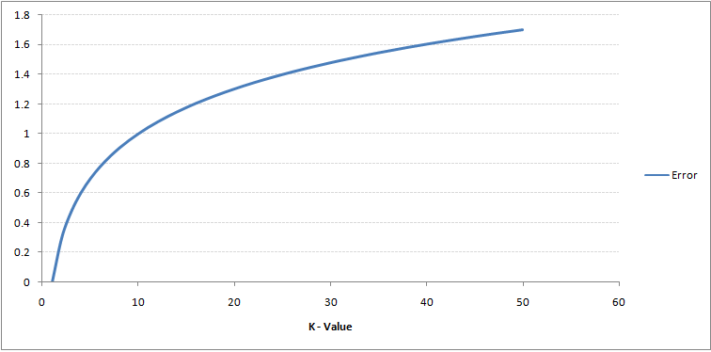
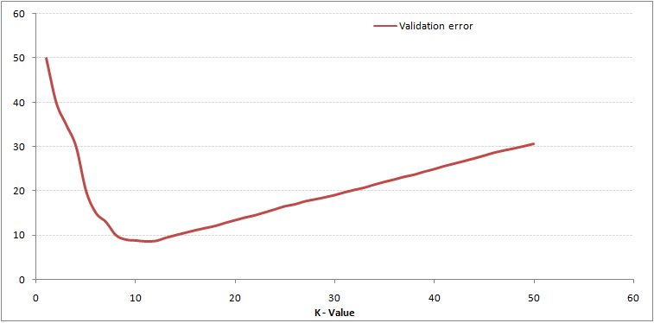
High Variance
Over fitting
High Bias
Under Fitting

Slide 60
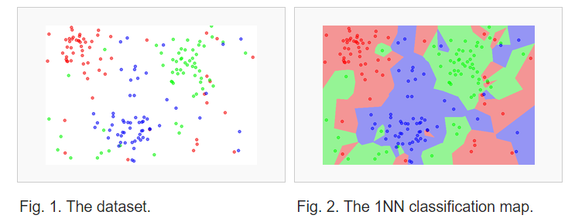
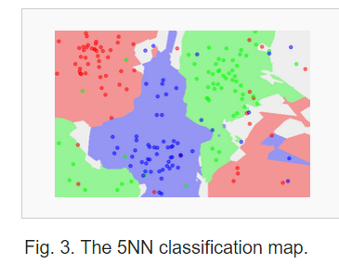

Slide 61
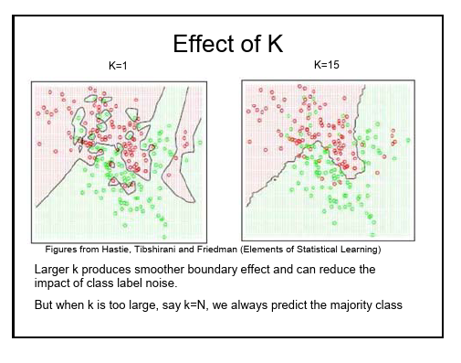

Slide 62
Handwritten digit recognition
Consider the following dataset, available from UCI. Thirty people wrote 3823 digits (0-9), which were then scanned as images and translated into 64 features. Specifically, each digit was scanned into a 32x32 pixel black-and-white image, which was divided into 4x4 pixel blocks (64 of them); the number of black pixels in each 4x4 block was counted. These counts constitute the 64 features.
The plot below shows each of the 3823 entities in the testing set. Because the feature vector of each entity has 64 dimensions, we cannot simply plot the feature vectors themselves. Instead, I reduced the dimensionality to 2D using “multidimensional scaling.” This technique calculates the distance from each entity to each other entity, creating a 3823x3823 matrix of distances. Then these distances are reduced to two dimensions by finding an x,y pair for each entity that respects its distances to the other entities. The scaling is not perfect, but generally serves as a good approximation of how “different” each entity is from each other entity.

Slide 63
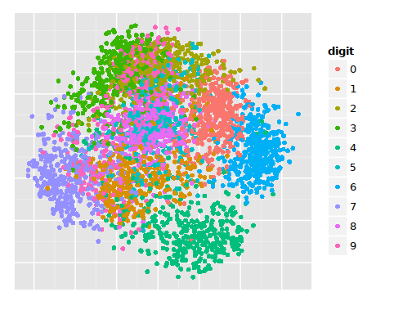
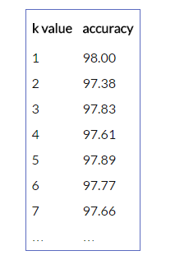
Never choose even values of K. Your algorithm in will be in the state of confusion when there is equal voting for all classes.

Slide 64
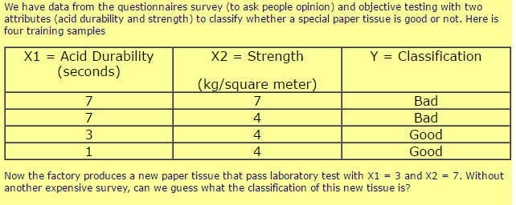
KNN Example Problem

Slide 65
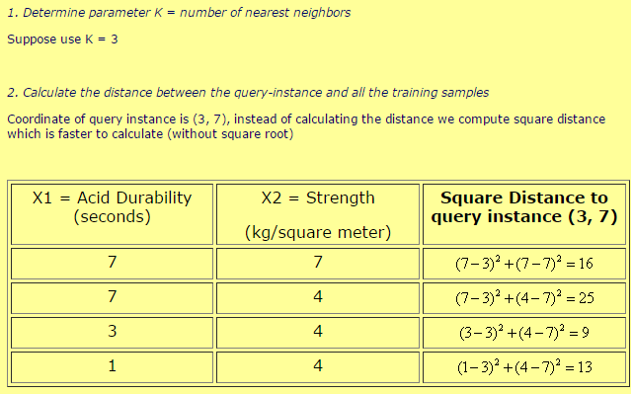

Slide 66


Slide 67


Slide 68

K-Means

Slide 69
Supervised learning vs. unsupervised learning
Supervised learning: discover patterns in the data that relate data attributes with a target (class) attribute.
These patterns are then utilized to predict the values of the target attribute in future data instances.
Unsupervised learning: The data have no target attribute.
We want to explore the data to find some intrinsic structures in them.

Slide 70
Clustering
Clustering is a technique for finding similarity groups in data, called clusters. I.e.,
it groups data instances that are similar to (near) each other in one cluster and data instances that are very different (far away) from each other into different clusters.
Clustering is often called an unsupervised learning task, as no class values denoting an a priori grouping of the data instances are given, which is the case in supervised learning.
Clustering is the classification of objects into different groups, or more precisely, the partitioning of a data set into subsets (clusters), so that the data in each subset (ideally) share some common trait - often according to some defined distance measure.

Slide 71

An illustration
The data set has three natural groups of data points, i.e., 3 natural clusters.

Slide 72
What is clustering for?
Let us see some real-life examples
Example 1: groups people of similar sizes together to make “small”, “medium” and “large” T-Shirts.
Tailor-made for each person: too expensive
One-size-fits-all: does not fit all.
Example 2: In marketing, segment customers according to their similarities
To do targeted marketing.

Slide 73
What is clustering for? (cont…)
Example 3: Given a collection of text documents, we want to organize them according to their content similarities,
To produce a topic hierarchy
In fact, clustering is one of the most utilized data mining techniques.
It has a long history, and used in almost every field, e.g., medicine, psychology, botany, sociology, biology, archeology, marketing, insurance, libraries, etc.
In recent years, due to the rapid increase of online documents, text clustering becomes important.

Slide 74
Aspects of clustering
A clustering algorithm
Partitional clustering
Hierarchical clustering
…
A distance (similarity, or dissimilarity) function
Clustering quality
Inter-clusters distance ⇒ maximized
Intra-clusters distance ⇒ minimized
The quality of a clustering result depends on the algorithm, the distance function, and the application.

Slide 75
K-means clustering
K-means is a partitional clustering algorithm
Partitional algorithms determine all clusters at once.
Let the set of data points (or instances) D be
{x₁, x₂, …, x_{n}},
where x_{i} = (x_{i1}, x_{i2}, …, x_{ir}) is a vector in a real-valued space X ⊆ R^{r}, and r is the number of attributes (dimensions) in the data.
The k-means algorithm partitions the given data into k clusters.
Each cluster has a cluster center, called centroid.
k is specified by the user

Slide 76
K-means algorithm
Step 1: Begin with a decision on the value of k =number of clusters .
Step 2: Put any initial partition that classifies the data into k clusters. You may assign the training samples randomly, or systematically as the following:
1.Take the first k training sample as single- element clusters
2. Assign each of the remaining (N-k) training sample to the cluster with the nearest centroid. After each assignment, recompute the centroid of the gaining cluster.

Slide 77
K-means algorithm
Step 3: Take each sample in sequence and compute its distance from the centroid of each of the clusters. If a sample is not currently in the cluster with the closest centroid, switch this sample to that cluster and update the centroid of the cluster gaining the new sample and the cluster losing the sample.
Step 4 . Repeat step 3 until convergence is achieved, that is until a pass through the training sample causes no new assignments.

Slide 78


Slide 79
A Simple example showing the implementation of k-means algorithm (using K=2)

Slide 80

Step 1:
Initialization: Randomly we choose following two centroids (k=2) for two clusters.
In this case the 2 centroid are: m1=(1.0,1.0) and m2=(5.0,7.0).

Slide 81



Step 2:
Thus, we obtain two clusters containing:
{1,2,3} and {4,5,6,7}.
Their new centroids are:

Slide 82

Step 3:
Now using these centroids we compute the Euclidean distance of each object, as shown in table.
Therefore, the new clusters are:
{1,2} and {3,4,5,6,7}
Next centroids are: m1=(1.25,1.5) and m2 = (3.9,5.1)

Slide 83

Step 4 :
The clusters obtained are:
{1,2} and {3,4,5,6,7}
Therefore, there is no change in the cluster.
Thus, the algorithm comes to a halt here and final result consist of 2 clusters {1,2} and {3,4,5,6,7}.

Slide 84
PLOT

Slide 85

(with K=3)
Step 1
Step 2

Slide 86

PLOT

Slide 87
Strengths of k-means
Strengths:
Simple: easy to understand and to implement
Efficient: Time complexity: O(tkn),
where n is the number of data points,
k is the number of clusters, and
t is the number of iterations.
Since both k and t are small. k-means is considered a linear algorithm.
K-means is the most popular clustering algorithm.

Slide 88
Weaknesses of k-means
The algorithm is only applicable if the mean is defined.
For categorical data, k-mode - the centroid is represented by most frequent values.
The user needs to specify k.
Note that: local optimum problem. The global optimum is hard to find due to complexity.
The algorithm is sensitive to outliers
Outliers are data points that are very far away from other data points.
Outliers could be errors in the data recording or some special data points with very different values.

Slide 89

Weaknesses of k-means: Problems with outliers

Slide 90
Weaknesses of k-means: To deal with outliers
One method is to remove some data points in the clustering process that are much further away from the centroids than other data points.
To be safe, we may want to monitor these possible outliers over a few iterations and then decide to remove them.
Another method is to perform random sampling. Since in sampling we only choose a small subset of the data points, the chance of selecting an outlier is very small.
Assign the rest of the data points to the clusters by distance or similarity comparison, or classification

Slide 91

Weaknesses of k-means (cont …)
The algorithm is sensitive to initial seeds.

Slide 92

Weaknesses of k-means (cont …)
If we use different seeds: good results
There are some methods to help choose good seeds

Slide 93

Weaknesses of k-means (cont …)
The k-means algorithm is not suitable for discovering clusters that are not hyper-ellipsoids (or hyper-spheres).
+

Slide 94
https://www.naftaliharris.com/blog/visualizing-k-means-clustering/

